Slide 1
PREDICTING CONSUMER BEHAVIOUR OF DIGITAL MARKETING IN DEEP LEARNING
Created By
M. Poorna Valli
Reg.No:912321104030
III year CSE
SACS MAVMM Engineering College, Madurai

Slide 2
Project Outline:
Problem Statement
Proposed System/Solution
System Development Approach
Algorithm And Deployment
Result
Conclusion
Reference

Slide 3
Problem Statement
Develop a deep learning model to predict consumer behavior in digital marketing campaigns. The model should analyze various factors such as demographics, browsing history, past purchase behavior, and engagement metrics to forecast the likelihood of consumers making a purchase or taking a specific action in response to marketing efforts.

Slide 4
Proposed System/Solution:
Data collection and preprocessing: Gather diverse datasets containing consumer information such as browsing history, purchase records, demographic details, and social media interactions.
Feature engineering: Extract meaningful features from the collected data that can help in understanding consumer behavior patterns. This may involve techniques such as time-series analysis and clustering similar consumer profiles.
Deep learning model design: Develop a deep learning architecture suitable for predicting consumer behavior.
Prediction and Evaluation:
Deploy the trained model to make predictions on unseen consumer data.
Evaluate the model's performance using metrics such as accuracy, precision, recall, and F1-score.

Slide 5
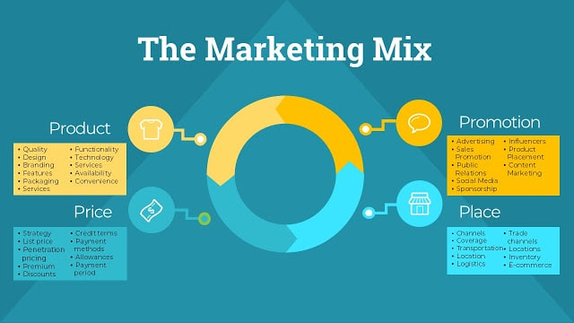
Proposed System/Solution: (Contd…,)
Monitoring and Iteration:
Continuously monitor the performance of the predictive model in real- world scenarios.
Collect feedback from marketing campaigns and consumer interactions to identify areas for improvement.

Slide 6
System Development Approach:
Hardware Requirements:
GPU (Graphics Processing Unit): Deep learning models benefit significantly from parallel processing, which GPUs excel at. High-end GPUs such as NVIDIA GeForce RTX or Tesla series are commonly used for training deep learning models.
CPU (Central Processing Unit): While GPUs handle the heavy lifting during training, CPUs are still important for overall system performance, data preprocessing, and handling other tasks simultaneously.
Memory (RAM): Deep learning models often require large amounts of memory, especially for handling large datasets during training. At least 16GB of RAM is recommended for medium-sized models and datasets, but more is preferable for larger ones.

Slide 7
System Development Approach: (Contd…,)
Storage: adequate storage space is essential for storing datasets, trained models, and intermediate results. SSDS (solid state drives) are preferred over HDDS (hard disk drives) due to their faster read/write speeds.
Hardware accelerators: specialized hardware accelerators such as TPUS (tensor processing units) or FPGAS (field-programmable gate arrays) can further speed up deep learning computations and reduce training time.

Slide 8
Software Requirements:
Data Collection Module: Capability to gather diverse data sources such as website traffic, social media interactions, email responses, etc. APIs to connect with platforms like Google Analytics, Facebook Insights, Twitter API, etc.
Deep Learning Model Architecture: Implementation of various deep learning architectures such as convolutional neural networks (CNNs), recurrent neural networks (RNNs), or transformers.
Training and Evaluation Module: for training deep learning models efficiently, which may include GPUs or TPUs for faster computation. Cross-validation techniques to assess model performance and prevent overfitting

Slide 9
Software Requirements: (Cont.…)
Deployment and integration: Deployment of trained models into production systems. Integration with existing digital marketing platforms or Apis to provide real-time insights.
Monitoring and maintenance: Monitoring tools to track model performance in production and detect drift or degradation. Regular updates and retraining of models to adapt to changing consumer behaviour patterns.
Security and compliance: Implementation of security measures to protect sensitive consumer data. Compliance with regulations such as GDPR, CCPA, etc., Regarding data privacy and consent.

Slide 10
Algorithm and deployment
Algorithm:
Step 1. Identify your business problem.
Step 2. Determine what metrics are necessary to address your problem.
Step 3: Determine which analysis technique you’ll use (determine the amount of data necessary).
Step 4: Collect historical data on all necessary metrics.
Step 5: Analyze the data including assessments of data quality.
Step 6: Communicate findings to organizational decision-makers.
Step 7: Implement decisions based on findings

Slide 11
Algorithm and deployment: (Cont.…)
Deployment:
Deploy the trained model in a production environment where it can make real-time predictions on consumer behaviour. This could involve integrating the model into an existing digital marketing platform or building a new application specifically for this purpose.

Slide 12
Conclusion:
Deep learning for predicting consumer behaviour in digital marketing holds immense potential for marketers to gain valuable insights and enhance their strategies. By harnessing the power of deep neural networks, marketers can analyse vast amounts of data from various digital channels to forecast consumer preferences, engagement levels, purchase intent, and conversion likelihood.

Slide 13
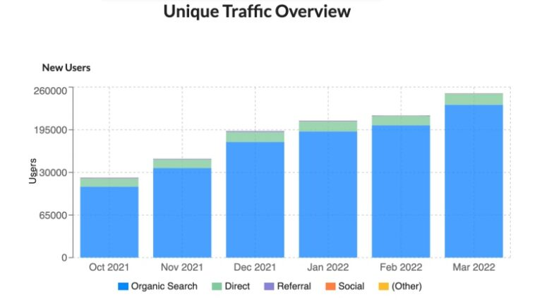
Result:

Slide 14
Reference:
https://www.sciencedirect.com/science/article/pii/S0957417420301676
https://www.sciencedirect.com/science/article/pii/S0167923621001329
https://link.springer.com/article/10.1007/s41870-024-01796-z

